Slide 1
Amrita School of Artificial Intelligence, Faridabad
Amrita Vishwa Vidyapeetham
Course Code: 23MAT214
Mathematics for Intelligent System-4
Part- 1.3
Shift Matrices and Circulant Matrices
BTech 4th Sem
*All Sources: Stanford University, Texas Tech University, UC Santa Barbara, etc.
*Sharing or distributing this lecture material without the permission of the lecture coordinator is strictly prohibited.

Slide 2
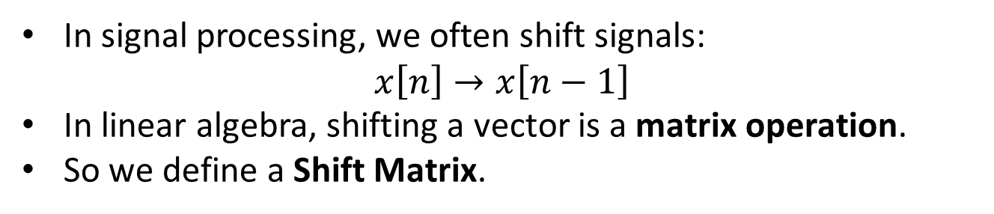
Motivation
In signal processing, we often shift signals:
$$x\left[n\right]→x\left[n−1\right]$$
In linear algebra, shifting a vector is a matrix operation.
So we define a Shift Matrix.
Key applications:
Digital Signal Processing (DSP): Used to model circular shifts, which represent delays in cyclic convolutions and graph signal processing.
Cryptography: Employed in algorithms like the Hill cipher for encoding plaintext.
Image Processing: Utilized for image rotation, scaling, and translating in computer graphics.
Linear Algebra & System Modeling: Used for solving equations with time-delays and studying cyclic permutations.
Data Analysis: Used in matrix data analysis diagrams for determining product characteristics.

Slide 3
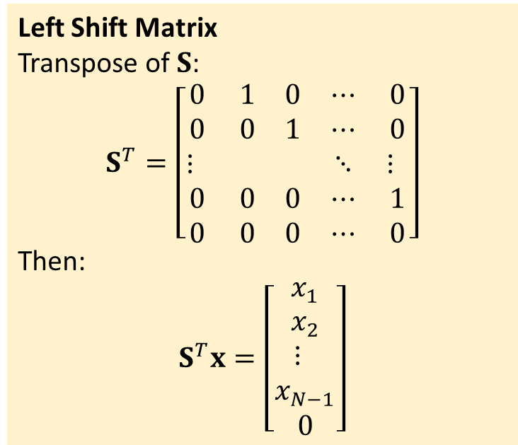
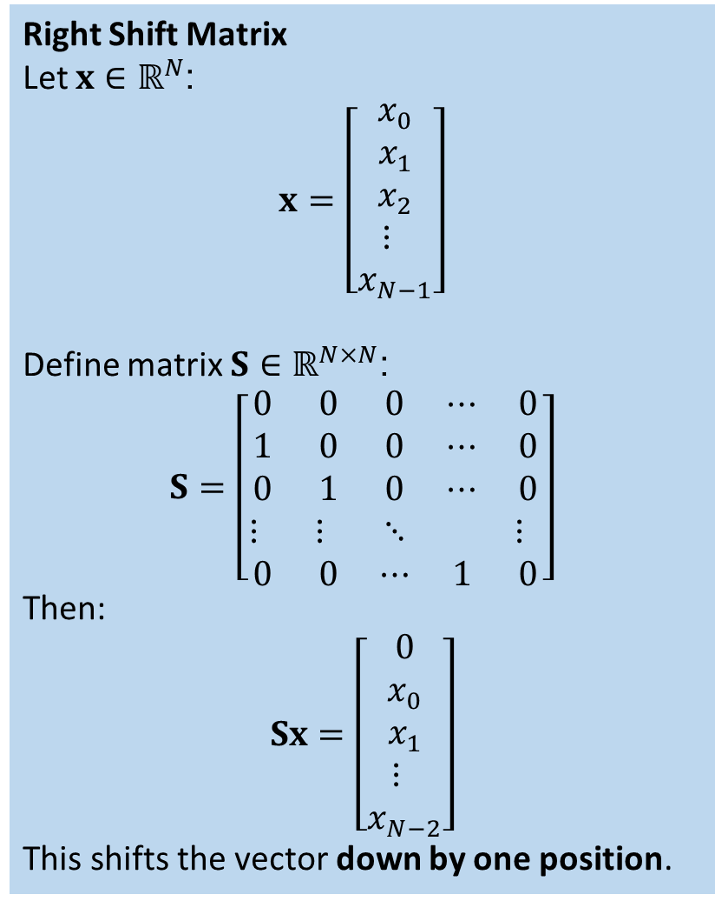
Right Shift Matrix
Let $x∈ℝ^{N}$:
$$x=\left[\begin{matrix}x_{0} \\ x_{1} \\ x_{2} \\ ⋮ \\ x_{N−1}\end{matrix}\right]$$
Define matrix $S∈ℝ^{N×N}$:
$$S=\left[\begin{matrix}0 & 0 & 0 & ⋯ & 0 \\ 1 & 0 & 0 & ⋯ & 0 \\ 0 & 1 & 0 & ⋯ & 0 \\ ⋮ & ⋮ & ⋱ & & ⋮ \\ 0 & 0 & ⋯ & 1 & 0\end{matrix}\right]$$
Then:
$$Sx=\left[\begin{matrix}0 \\ x_{0} \\ x_{1} \\ ⋮ \\ x_{N−2}\end{matrix}\right]$$
This shifts the vector down by one position.
Left Shift Matrix
Transpose of $S$:
$$S^{T}=\left[\begin{matrix}0 & 1 & 0 & ⋯ & 0 \\ 0 & 0 & 1 & ⋯ & 0 \\ ⋮ & & & ⋱ & ⋮ \\ 0 & 0 & 0 & ⋯ & 1 \\ 0 & 0 & 0 & ⋯ & 0\end{matrix}\right]$$
Then:
$$S^{T}x=\left[\begin{matrix}x_{1} \\ x_{2} \\ ⋮ \\ x_{N−1} \\ 0\end{matrix}\right]$$

Slide 4
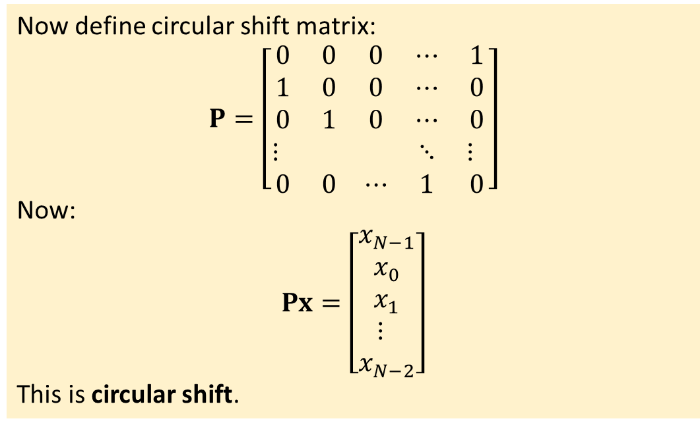
Circular Shift Matrix
Now define circular shift matrix:
$$P=\left[\begin{matrix}0 & 0 & 0 & ⋯ & 1 \\ 1 & 0 & 0 & ⋯ & 0 \\ 0 & 1 & 0 & ⋯ & 0 \\ ⋮ & & & ⋱ & ⋮ \\ 0 & 0 & ⋯ & 1 & 0\end{matrix}\right]$$
Now:
$$Px=\left[\begin{matrix}x_{N−1} \\ x_{0} \\ x_{1} \\ ⋮ \\ x_{N−2}\end{matrix}\right]$$
This is circular shift.

Slide 5
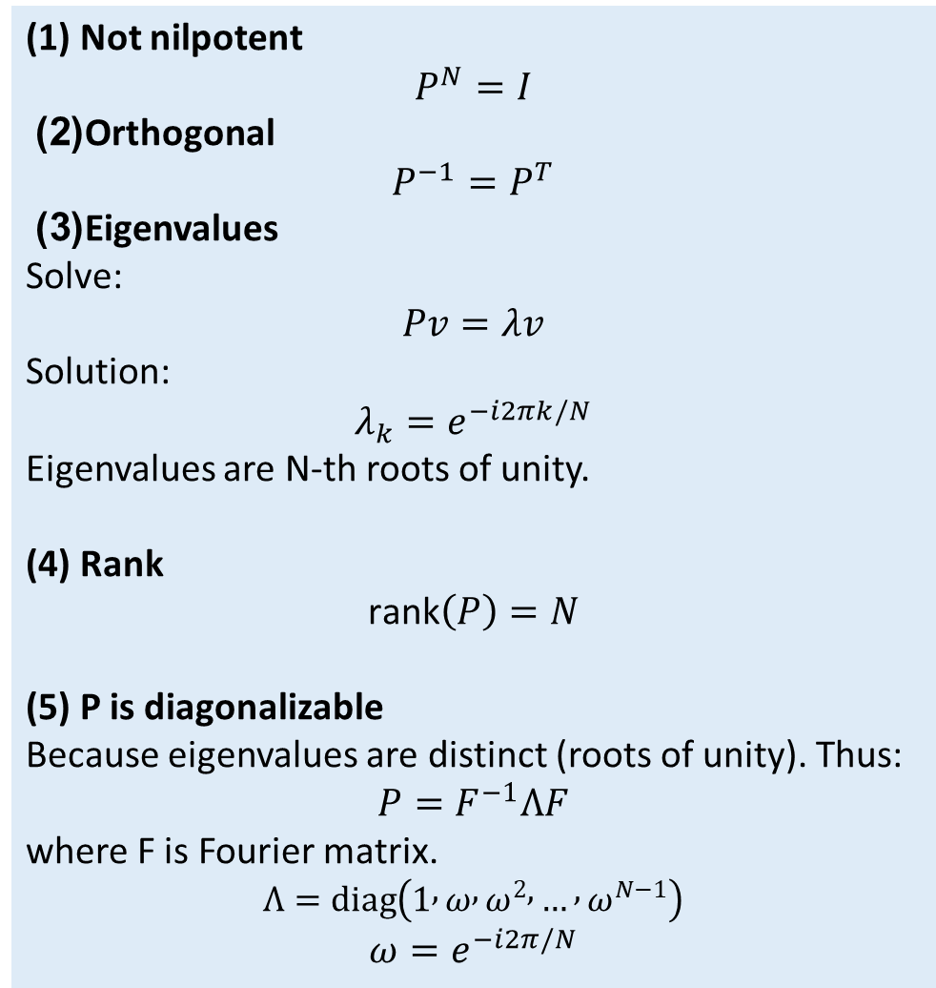
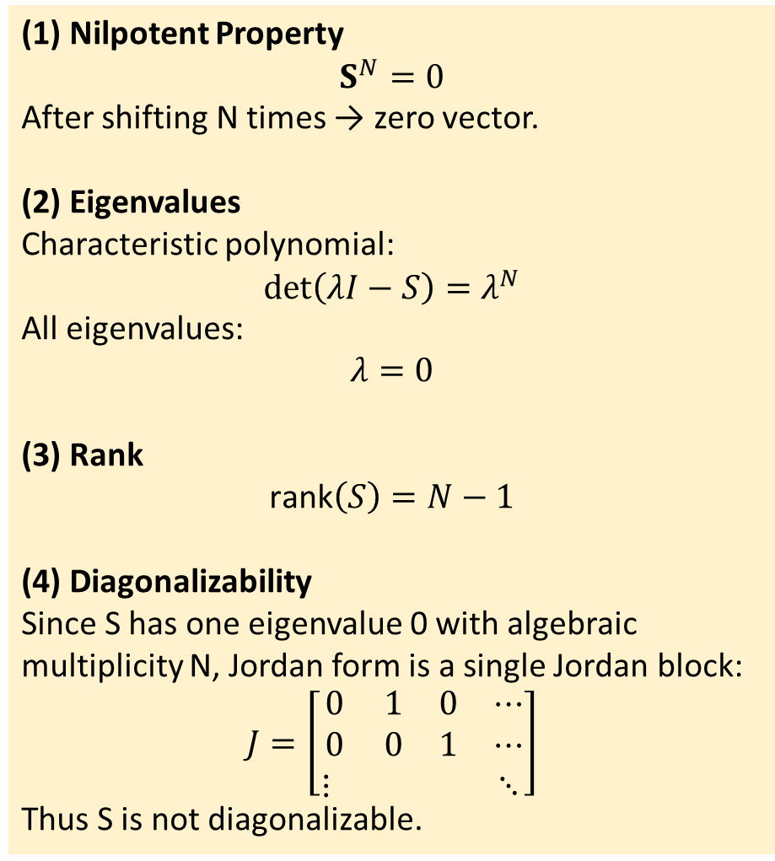
Properties of non-circular Shift Matrix
Properties of circular Shift Matrix
(1) Nilpotent Property
$$S^{N}=0$$
After shifting N times → zero vector.
(2) Eigenvalues
Characteristic polynomial:
$$det⁡\left(λI−S\right)=λ^{N}$$
All eigenvalues:
$$λ=0$$
(3) Rank
$$\text{rank}\left(S\right)=N−1$$
(4) Diagonalizability
Since S has one eigenvalue 0 with algebraic multiplicity N, Jordan form is a single Jordan block:
$$J=\left[\begin{matrix}0 & 1 & 0 & ⋯ \\ 0 & 0 & 1 & ⋯ \\ ⋮ & & & ⋱\end{matrix}\right]$$
Thus S is not diagonalizable.
(1) Not nilpotent
$$P^{N}=I$$
(2) Orthogonal
$$P^{−1}=P^{T}$$
(3) Eigenvalues
Solve:
$$Pv=λv$$
Solution:
$$λ_{k}=e^{−i2πk/N}$$
Eigenvalues are N-th roots of unity.
(4) Rank
$$\text{rank}\left(P\right)=N$$
(5) P is diagonalizable
Because eigenvalues are distinct (roots of unity). Thus:
$$P=F^{−1}ΛF$$
where F is Fourier matrix.
$$Λ=diag⁡\left(1 , ω , ω^{2} , … , ω^{N−1}\right)$$
$$ω=e^{−i2π/N}$$

Slide 6
Property | S | P
Zero padding | Yes | No
Circular | No | Yes
Determinant | 0 | ±1
Invertible | No | Yes
Nilpotent | Yes | No
Eigenvalues | All 0 | Roots of unity
Diagonalizable | No | Yes
Group structure | No | Yes
Energy preserving | No | Yes
Used in DFT | No | Yes

Slide 7

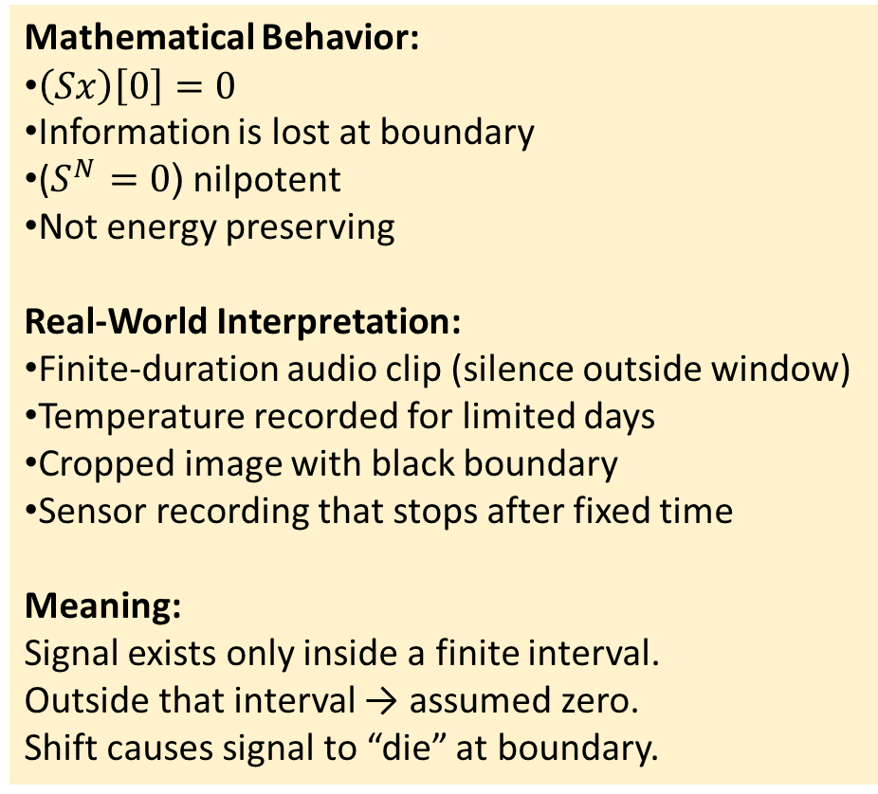

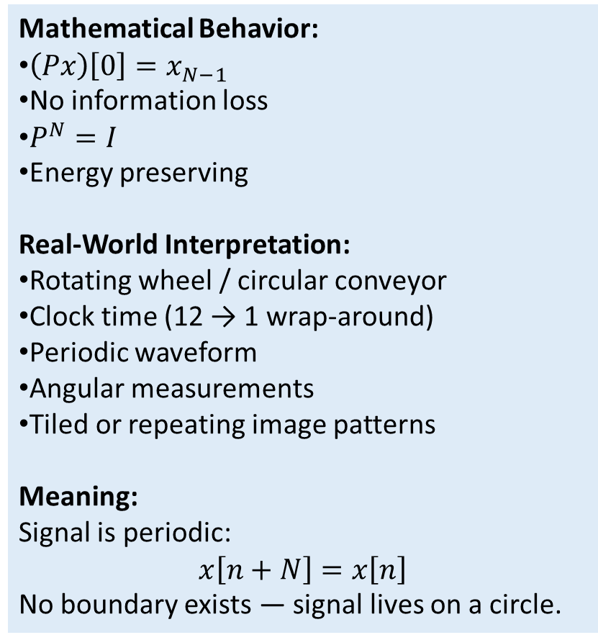
Shift Matrix $S$(Zero Padding Model)
Circular Shift Matrix $P$(Periodic Model)
Mathematical Behavior:
$\left(Sx\right)\left[0\right]=0$
Information is lost at boundary
($S^{N}=0$( nilpotent
Not energy preserving
Real-World Interpretation:
Finite-duration audio clip (silence outside window)
Temperature recorded for limited days
Cropped image with black boundary
Sensor recording that stops after fixed time
Meaning:
Signal exists only inside a finite interval.
Outside that interval → assumed zero.
Shift causes signal to “die” at boundary.
Mathematical Behavior:
$\left(Px\right)\left[0\right]=x_{N−1}$
No information loss
$P^{N}=I$
Energy preserving
Real-World Interpretation:
Rotating wheel / circular conveyor
Clock time (12 → 1 wrap-around)
Periodic waveform
Angular measurements
Tiled or repeating image patterns
Meaning:
Signal is periodic:
$$x\left[n+N\right]=x\left[n\right]$$
No boundary exists — signal lives on a circle.

Slide 8
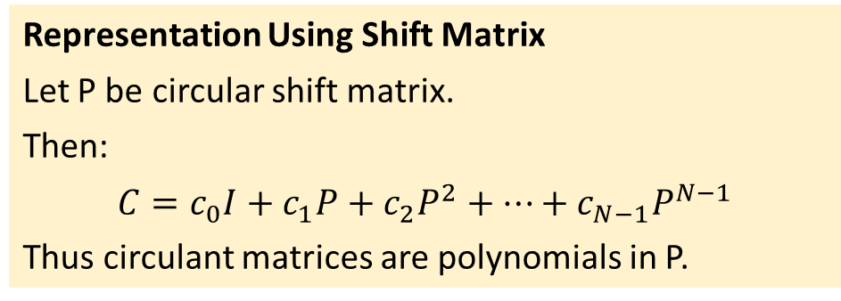
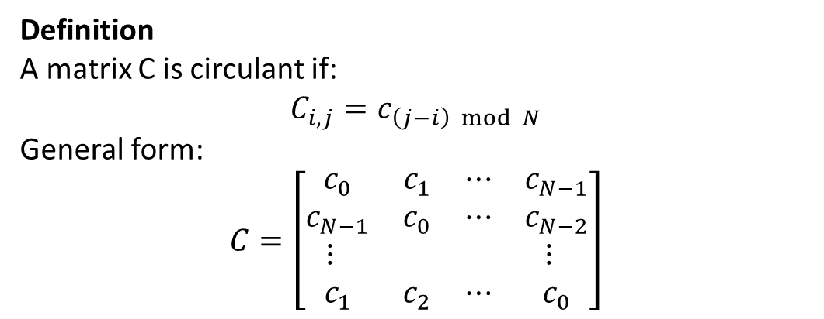
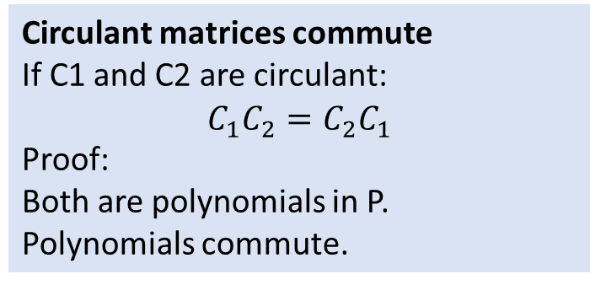
CIRCULANT MATRICES
Definition
A matrix C is circulant if:
$$C_{i,j}=c_{\left(j−i\right) mod N}$$
General form:
$$C=\left[\begin{matrix}c_{0} & c_{1} & ⋯ & c_{N−1} \\ c_{N−1} & c_{0} & ⋯ & c_{N−2} \\ ⋮ & & & ⋮ \\ c_{1} & c_{2} & ⋯ & c_{0}\end{matrix}\right]$$
Circulant matrices commute
If C1 and C2 are circulant:
$$C_{1}C_{2}=C_{2}C_{1}$$
Proof:
Both are polynomials in P.
Polynomials commute.
Representation Using Shift Matrix
Let P be circular shift matrix.
Then:
$$C=c_{0}I+c_{1}P+c_{2}P^{2}+⋯+c_{N−1}P^{N−1}$$
Thus circulant matrices are polynomials in P.

Slide 9
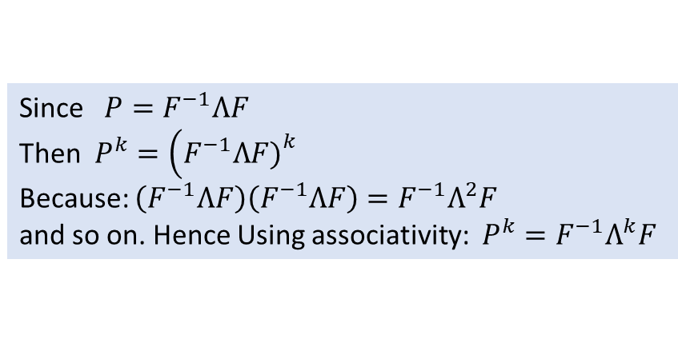
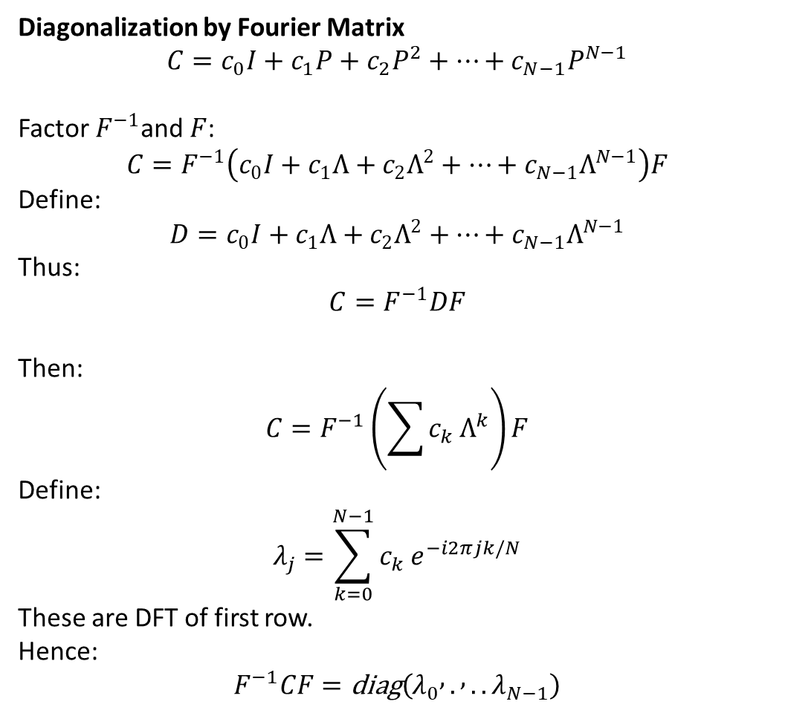
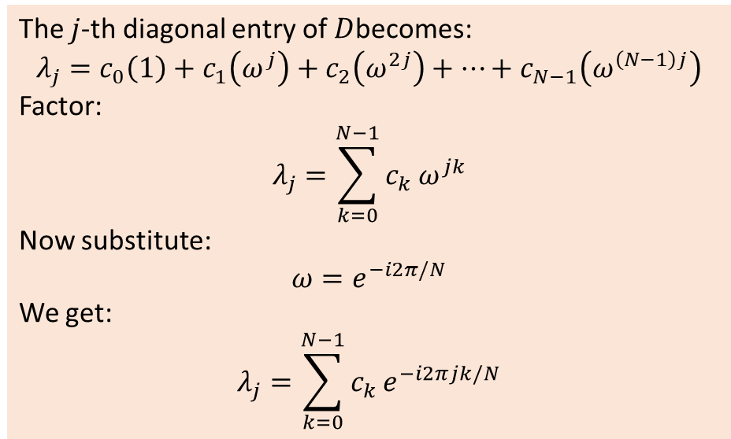
Diagonalization by Fourier Matrix
$$C=c_{0}I+c_{1}P+c_{2}P^{2}+⋯+c_{N−1}P^{N−1}$$
Factor $F^{−1}$and $F$:
$$C=F^{−1}\left(c_{0}I+c_{1}Λ+c_{2}Λ^{2}+⋯+c_{N−1}Λ^{N−1}\right)F$$
Define:
$$D=c_{0}I+c_{1}Λ+c_{2}Λ^{2}+⋯+c_{N−1}Λ^{N−1}$$
Thus:
$$C=F^{−1}DF$$
Then:
$$C=F^{−1}\left(\sum{c_{k}}Λ^{k}\right)F$$
Define:
$$λ_{j}=\sum_{k=0}^{N−1}{c_{k}}e^{−i2πjk/N}$$
These are DFT of first row.
Hence:
$$F^{−1}CF=\text{diag}\left(λ_{0} , . , ..λ_{N−1}\right)$$
Since $P=F^{−1}ΛF$
Then $P^{k}=\left(F^{−1}ΛF{\left.)\right.}^{k}\right.$
Because: $\left(F^{−1}ΛF\right)\left(F^{−1}ΛF\right)=F^{−1}Λ^{2}F$
and so on. Hence Using associativity: $P^{k}=F^{−1}Λ^{k}F$
The $j$-th diagonal entry of $D$becomes:
$$λ_{j}=c_{0}\left(1\right)+c_{1}\left(ω^{j}\right)+c_{2}\left(ω^{2j}\right)+⋯+c_{N−1}\left(ω^{\left(N−1\right)j}\right)$$
Factor:
$$λ_{j}=\sum_{k=0}^{N−1}{c_{k}}ω^{jk}$$
Now substitute:
$$ω=e^{−i2π/N}$$
We get:
$$λ_{j}=\sum_{k=0}^{N−1}{c_{k}}e^{−i2πjk/N}$$

Slide 10
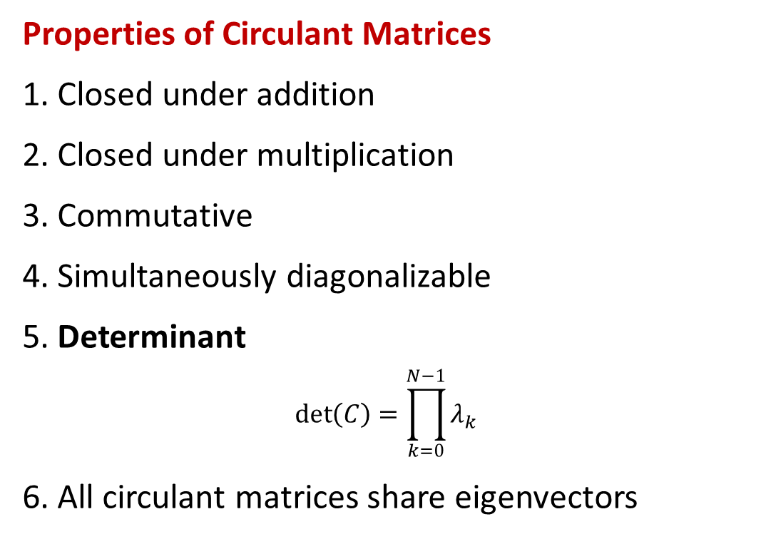
Properties of Circulant Matrices
Closed under addition
Closed under multiplication
Commutative
Simultaneously diagonalizable
5. Determinant
$$det⁡\left(C\right)=\prod_{k=0}^{N−1}{λ_{k}}$$
6. All circulant matrices share eigenvectors

